Slide 1
Finance KPIs - data sources

Slide 2
Challenge instructions:
To complete this challenge, you need to make a copy of these slides in your own Drive (File > Make a copy > Entire presentation ).
You will find 3 diagrams representing different business models. On each diagram, you need to determine the data necessary to
calculate the KPIs and determine their position in the business chain. Write the required data sources in the orange boxes
on the slides.

Slide 3
Finance

Slide 4









Lecture reminder: objectives of the finance team - order model
Mission
Ensure the company is financially healthy, with sufficient cash flow and profitability
Manage the company’s financial statements
Monitor the profitability, financial and cash-in/cash-out performance, with reliable data
Optimize the cost structure
Data use
How to measure:
KPIs
Turnover
Orders,
Average basket
Purchase price,
Operations costs
Ads costs
Gross margin, Operating margin rate
Examples of sources
Sales
Sales
Purchasing costs
Ads costs
Refunds
Cash-in
Cash-in
Cash-out
Cash-out
Cash-out
Operations costs
Cash-out

Slide 5
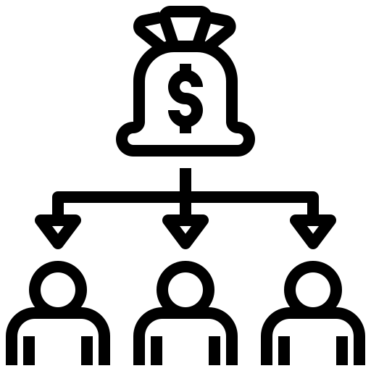

Lecture reminder: objectives of the finance team - subscription model
Mission
Ensure the company is financially healthy, with sufficient cash flow and profitability
Manage the company’s financial statements
Monitor the profitability, financial and cash-in/cash-out performance, with reliable data
Optimize the cost structure
Data use
How to measure:
KPIs
Annual Recurring Revenue
Monthly Recurring Revenue
Payroll
Inventory Turnover
Gross margin, Operating margin rate
Examples of sources
Subscriptions
Subscriptions
Operations costs
Storage costs
Cash-in
Cash-in
Cash-out
Cash-out

Slide 6
Finance
Let's focus on the primary data usage: financial management.
The objective is to gather all the costs and revenues associated with the company's operations to track profitability over time.
For each of the following business models, identify the data required to calculate finance KPIs.
At which stage of the business value chain would you find them? Write the data source in the orange boxes on your own slides.

Slide 7











E-commerce Model
ADS COST
MARKETING COST
purchasing cost
REVENUE
REFUNDS
Ads
Mail
Supply
Payment
Refunds
Activity model
Traffic
User
Products
Order
Shipping
Customer
relations
Data
SERVER COST
STORAGE COST
SALES
Operation cost
CUSTOMERS
Media
CRM
Marketing (com’, pricing and commercial animation)
Operation team (logistic and shipping)
Service
IT
Traffic Management
Purchase
Finance
Customer service
Ads campaigns reporting
Customers base animation
Business activity monitoring
Delivery tracking
Use Case
Traffic optimisation
Inventory management
Financial profitability reports
Customers satisfaction analysis

Slide 8






Industry Model
R&D COST
human ressource cost
ads cost
revenu
MARKETING COST
R&D
Recruitment
Ads
Payment
Mail
Activity model
Supply
Production
Sales
Client
Customer
relations
Data
PURCHASE COST
operation cost
COG cost of good sold
Research & Development
Human resources
Finance
Customer success/care
Service
Purchase
Operation team
Media
Sales
Predictive maintenance
Capacity planning
Campaign optimisation
FInancial management
Customers satisfaction monitoring
Use Case
Inventory management
Production reporting
Lead funnel monitoring

Slide 9


SaaS Model
DEV SALARY COST
ADS COST
REVENUE
MARKETING COST
Tech
Ads
Payment
Mail
Activity model
Product
Sales
Client
Customer support
Data
USAGE COST
COG / cost of good sold
IT
Media
Finance
Customer care/success
Service
Product
Sales
CRM
Campaign optimisation
FInancial management
Customers satisfaction monitoring
Use Case
Traffic analysis and product optimisation
Lead funnel monitoring
Customers base animation

